Slide 1

Development of an Aerial Air Quality Monitoring Platform Based on Vertical Takeoff and Landing (VTOL) Unmanned Aerial Vehicle (UAV)
20/12/2021
ME FYP Group 29: Cheung Hiu Ching, Athena
Fung Ka Chun, Tim
Liu Sum Yin, Kylie
https://github.com/Athenachc/2021_FYP_ME_VTOL-UAV

Slide 2
Contents
Current progress
Interim report
Flying test
Future plan
Simulation – CFD
Carbon Fiber wings (Fuselage)

Slide 3
Current progress
Interim report

Slide 4
Contents
Nomenclature
Introduction
Background
Objectives
Literature review
Introduction of UAV
Introduction of VTOL
Comparison between different types of UAV
Aerodynamics of fixed wing VTOL UAV
Composite wing
Methodology
Design flowchart
VTOL Skywalker X8 UAV design
3D scanning of Skywalker X8
Calculation and simulation in computational fluid dynamics(CFD)
Reason of selecting Clark Y airfoil
Project planning
Project schedule
Gantt chart

Slide 5
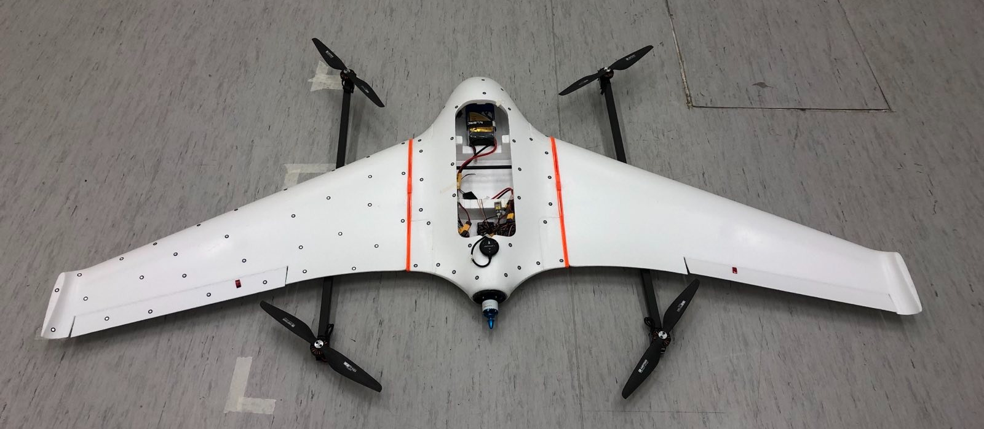
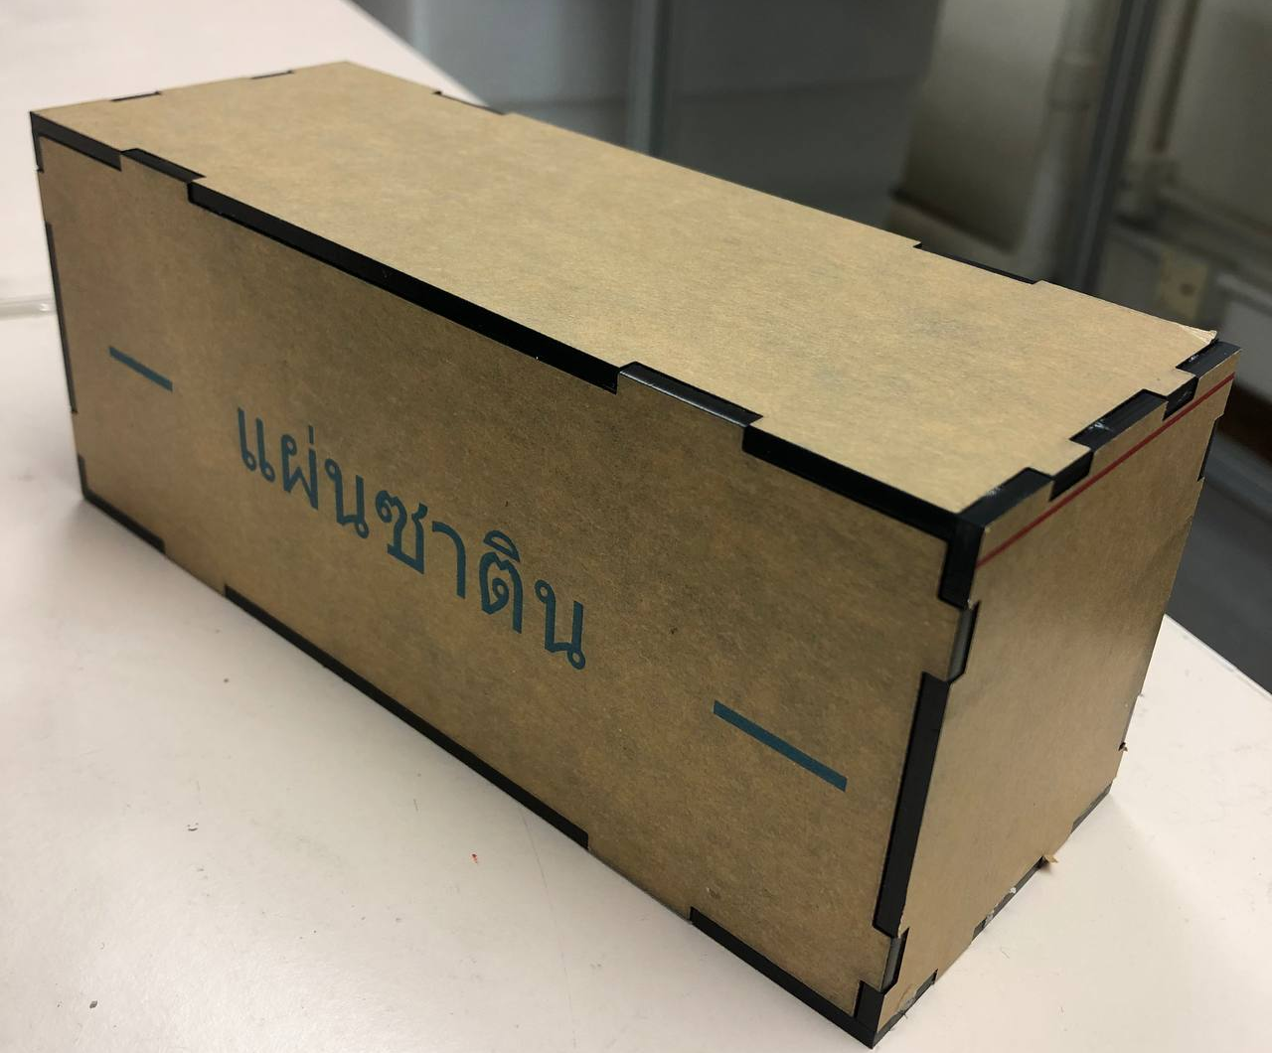
Introduction
Background
Referring to the Innovation and Technology Fund (ITF) project
Air pollution monitoring in the Great Bay Aera by a VTOL UAV
Airframe selection of the VTOL UAV
Reinforcement of the mechanical structure of a VTOL UAV
Objectives
Complete the flight task with the requirements
Redesign the wings
Manufacturing fuselage and wings

Slide 6
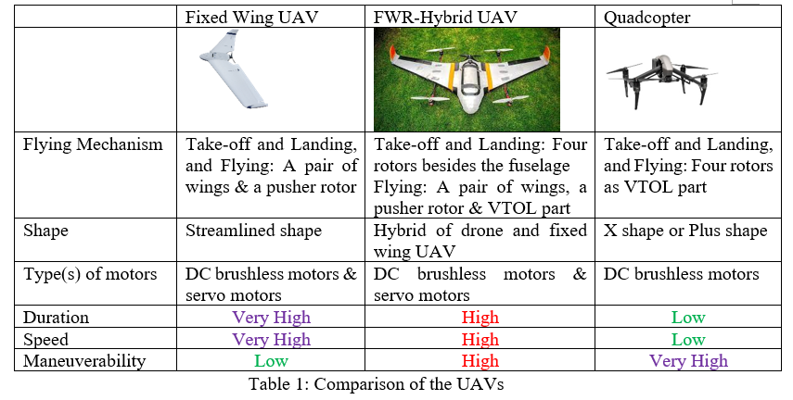
Literature review:
Aseem Saini and Mukul Chhabra, “Hybrid VTOL-UAV for Air Delivery and Sampling Purposes”, B.Tech dissertation, Dept. Elect & Com. Eng., Indraprastha Institute of Information Technology,. New Delhi, 2018.
Chika Yinka-Banjo and Olasupo Ajayi, “Sky-Farmers: Applications of Unmanned Aerial Vehicles (UAV) in Agriculture,” IntechOpen, 2019.
D. Baek, Y. Chen, A. Bocca, A. Macii, E. Macii, and M. Poncino, “Battery-Aware Energy Model of Drone Delivery Tasks,” in Proceedings of the International Symposium on low power electronics and design, 2018, pp. 1–6, doi: 10.1145/3218603.3218614.

Slide 7
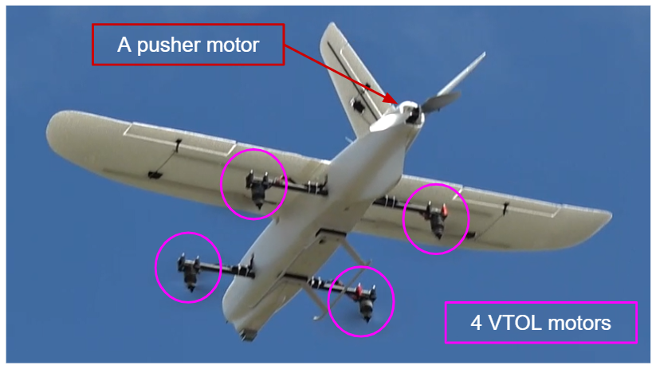
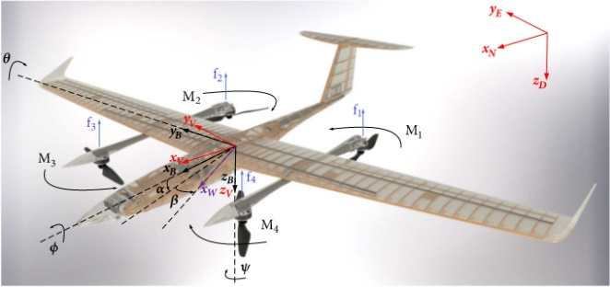
Literature review:
A “4+1” fixed-wing VTOL UAV which was built by one of our teammates
A VTOL aircraft with its four motors
(M_1,M_2,M_3 and M_4)
A. Mathur, E. M. Atkins, “Design, Modeling and Hybrid Control of a QuadPlane”, presented at AIAA Scitech 2021 Forum. [Online]. Available: https://www.researchgate.net/publication/348254161_Design_Modeling_and_Hybrid_Control_of_a_QuadPlane [Accessed Nov. 20, 2021].

Slide 8
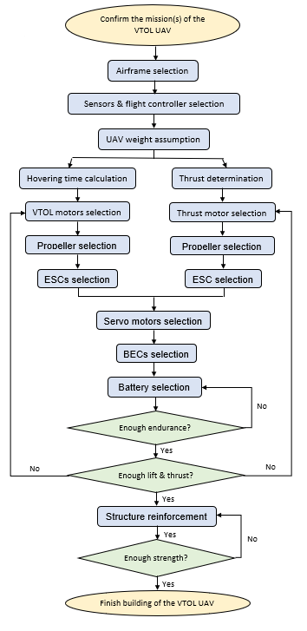
Methodology: Design flowchart of building a VTOL UAV

Slide 9
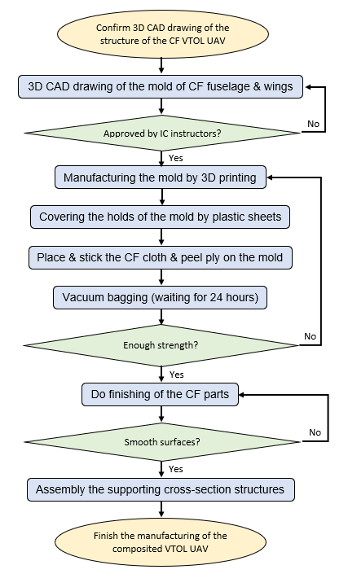
Methodology: Design flowchart of structure reinforcement by manufacturing a composited VTOL UAV

Slide 10
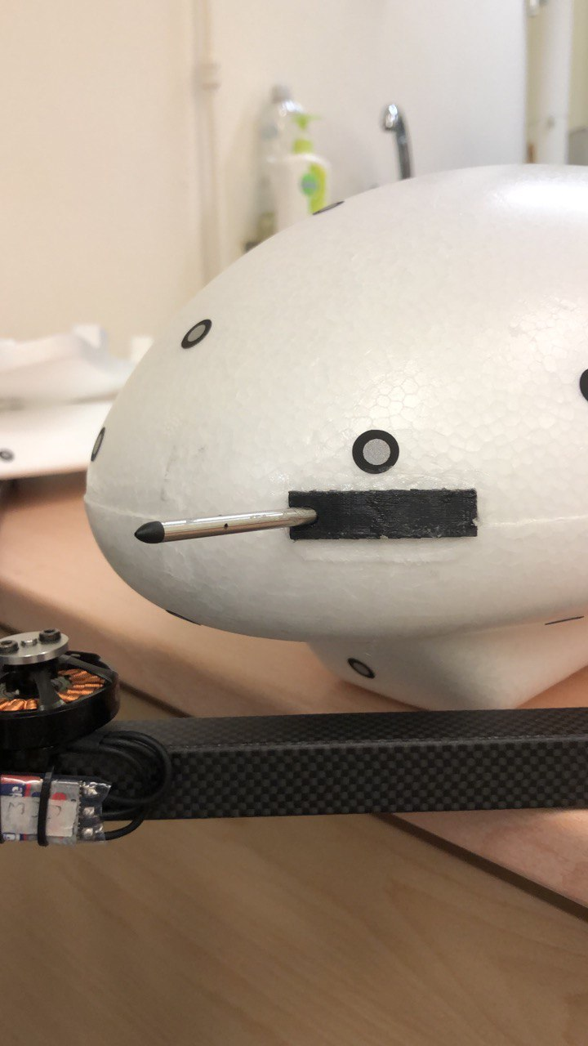
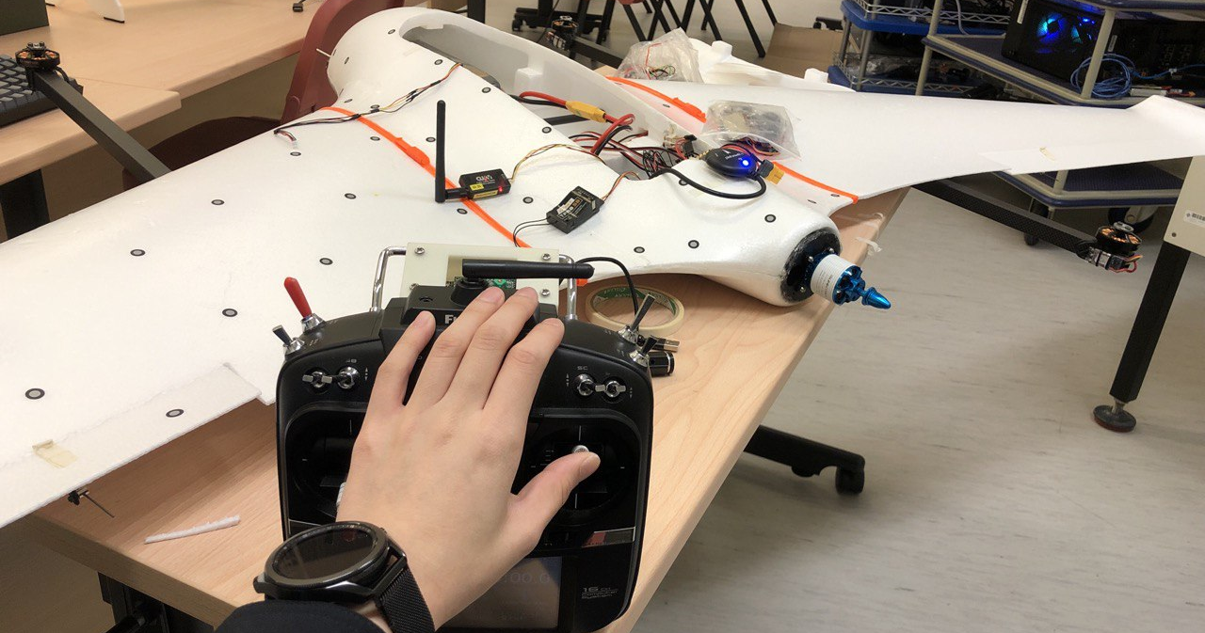
Methodology: VTOL Skywalker X8 UAV design

Slide 11
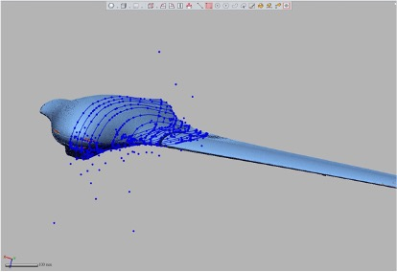
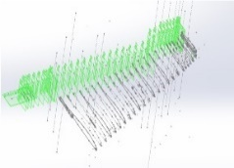
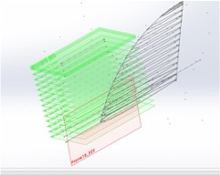
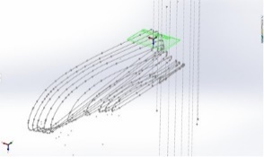
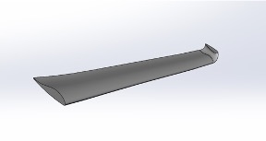
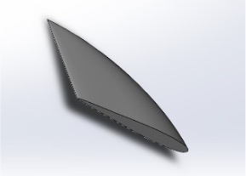
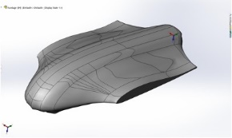
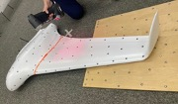
Methodology: 3D scanning of Skywalker X8

Slide 12
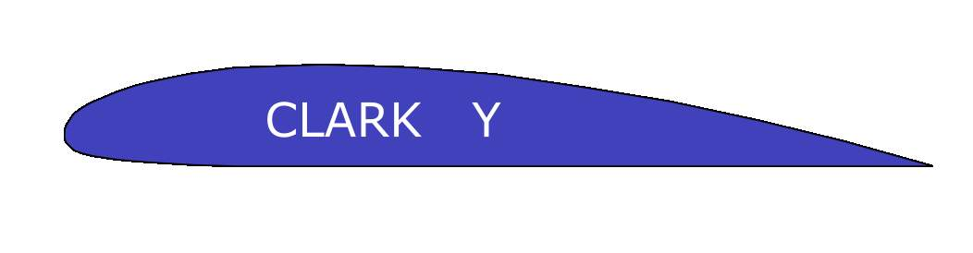
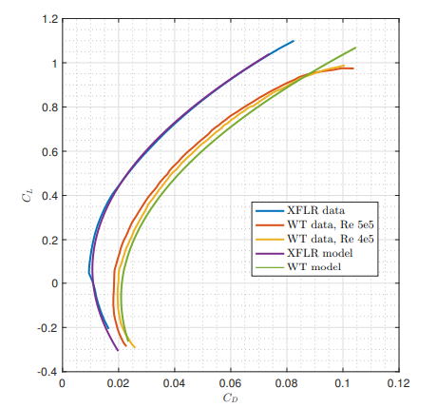
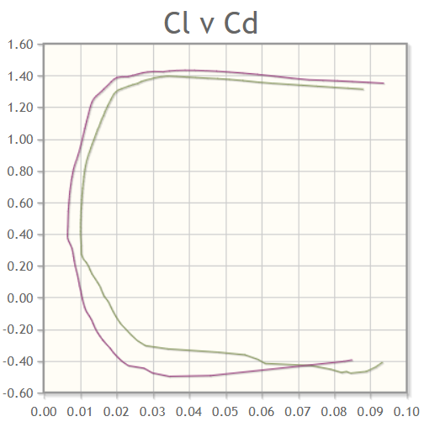
Methodology: Reason of selecting Clark Y airfoil - Better aerodynamics performance - Flat low surface
Lift coefficient vs. drag coefficient of Skywalker X8
Lift coefficient vs. drag coefficient of Clark Y airfoil

Slide 13
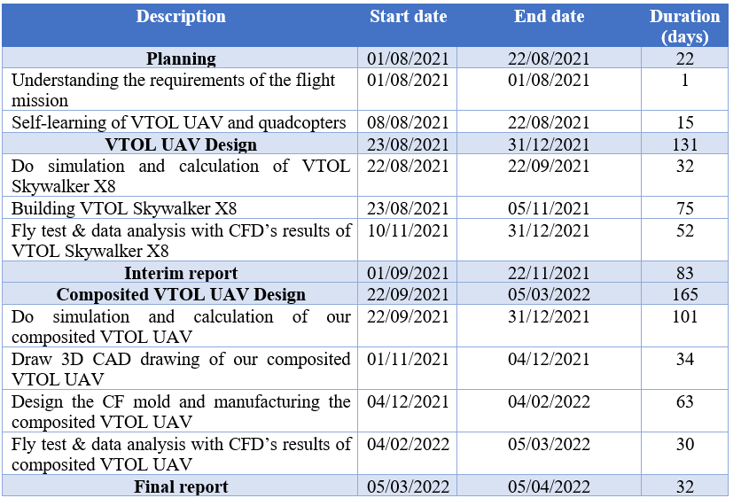
Project schedule

Slide 14
Gantt chart

Slide 15
Gantt chart

Slide 16
Current progress
Flying test

Slide 17
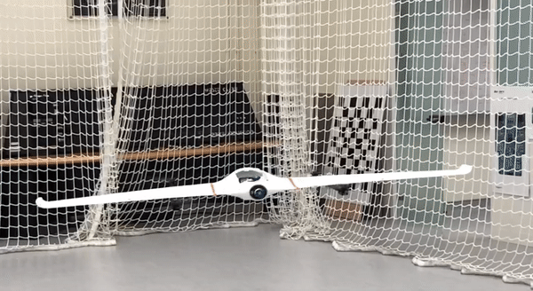
Flying test - Hovering

Slide 18
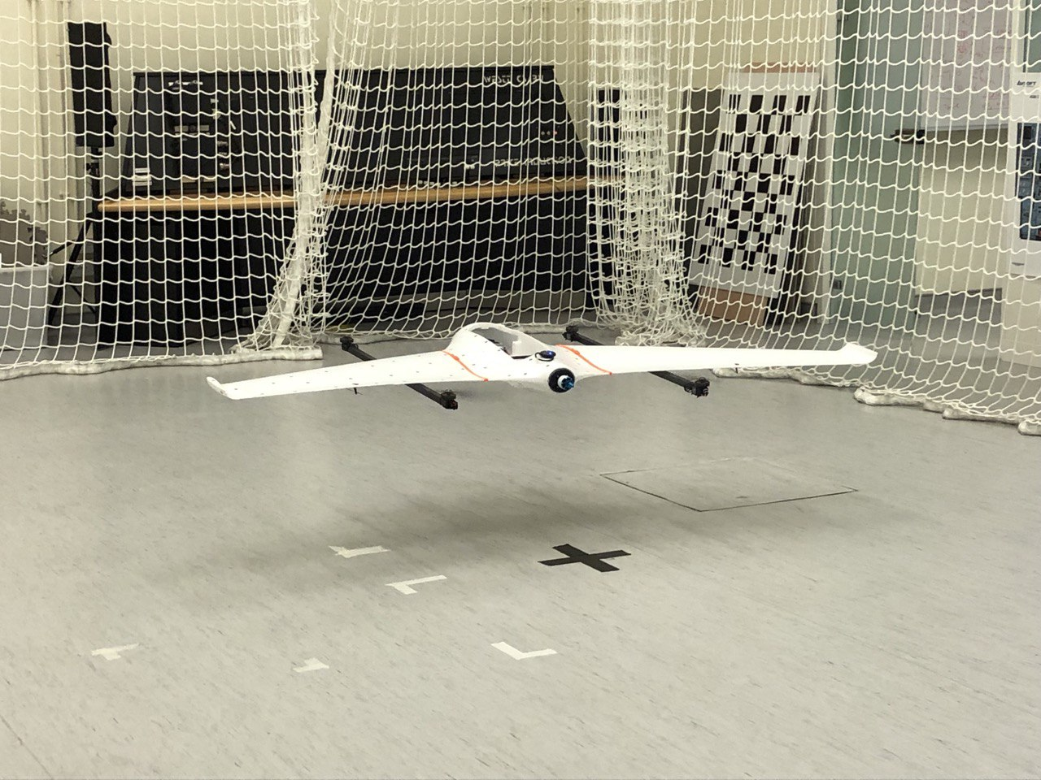
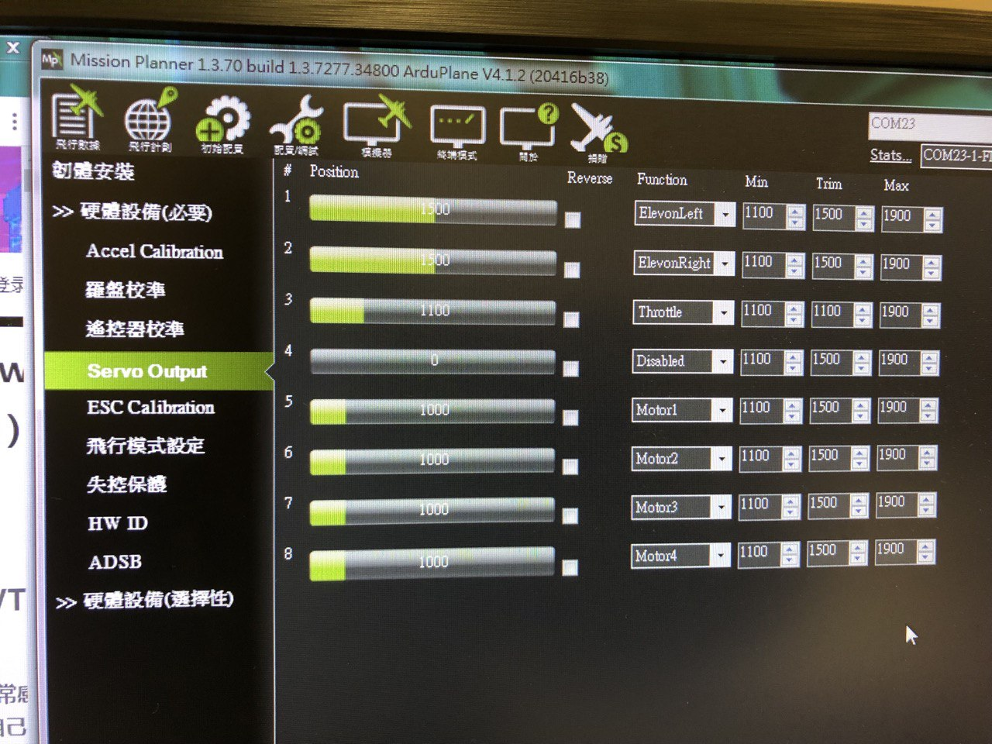
Flying test - Hovering

Slide 19
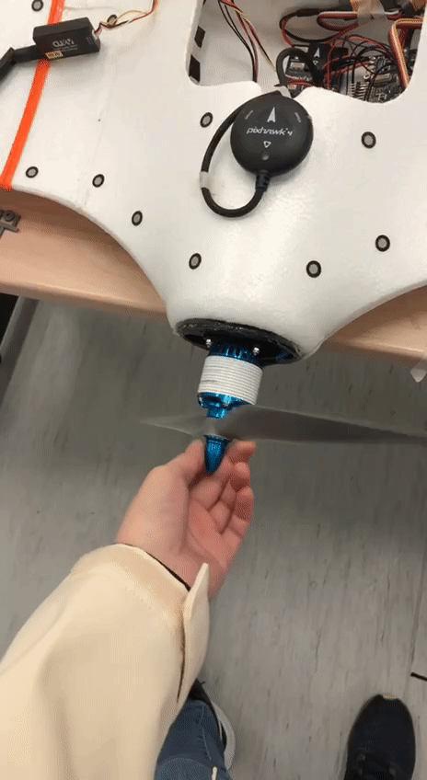
Flying test – Preflight checking for cruise
Pusher motor propellor: 13” CCW
Rotation of pusher motor: CCW

Slide 20
Future plan
Simulation - CFD

Slide 21

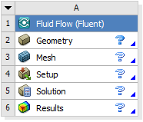
Ansys Fluent
Major Steps
Create the fluid volume (Geometry)
Create mesh (Mesh)
Launch FLUENT (Setup)
Get the results (Results)

Slide 22
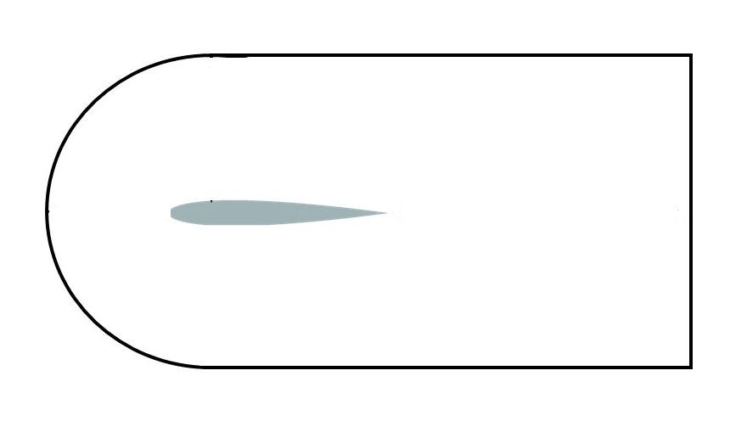
Geometry
Import airfoil from SolidWorks/Airfoil datafile
Construct C-type fluid volume for further processing

Slide 23
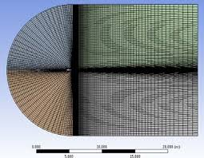
Mesh
C-Mesh
Round velocity inlet
Flat pressure outlet
Better convergence of flow
Control the wall and the function of the mesh

Slide 24
Setup
Laminar flow is assumed
Air as fluid
Define the cell zones and boundary conditions
Velocity magnitude and direction
Adjust number of grid points and iterations for better resolution

Slide 25
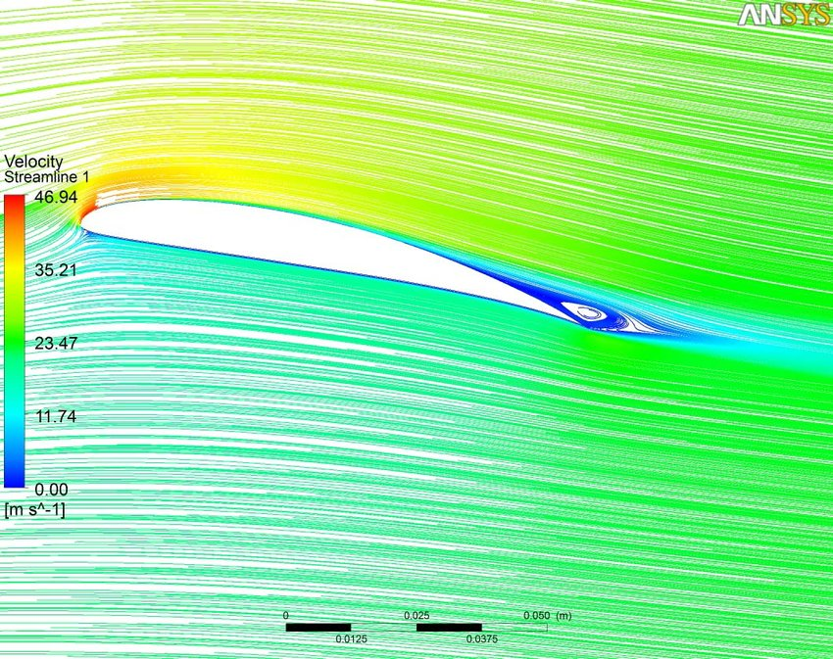
Results
Lift coefficient curve
Drag coefficient curve
Streamline flow and velocity
e.g.

Slide 26
Future plan
Carbon fiber wings (& fuselage)

Slide 27
Carbon fiber wings (& fuselage)
3D CAD model
Simulation (CFD & calculation)
CF mold
Manufacturing CF wings & fuselage (with cross-section structure)

Slide 28
Gantt chart

Slide 29
Thank you

